Slide 1
Rising Senior Night March 25, 2026

Slide 2
Tonight juniors and their parents can expect to learn about the post-high school process and how to prepare for senior year.

Slide 3

What Do You Want to Do?
College?
Military?
Trade School?
Workforce?
Still thinking about it?
There Is A Place For Everyone!

Slide 4
So What Should I Do…and When?

Slide 5
March-August 2026
Q1
Make your college or trade school list based on your goals
Request fee waivers for college entrance exams or application fees
Take or schedule your ACT and/or SAT
Write your college essays
Update your resume
Tour your schools if you haven’t already
Consider which teachers you will approach about writing letters of recommendation
Create your account on your application platform of choice

Slide 6
September-October 2026
Q2
Reapply for free/reduced lunch if you qualify
Submit your applications on your platform of choice
Attend the district college fair in October
Complete your FAFSA/TASFA (October) and upload proof in SchooLinks to satisfy graduation requirement
Update your SchooLinks account with your personal email address
Request teacher letters of recommendation in SchooLinks
Request counselor recommendations and/or School Reports in SchooLinks
Request initial transcripts in SchooLinks

Slide 7
November 2026 - February 2027
Q3
Start applying for school-based scholarships
Submit applications to colleges with November-February deadlines to ensure you don’t miss out on scholarships
Take the ASVAB if you are planning on joining the military
Ensure mid-year transcripts are sent to your schools who require them (mid-January)
Bookmark all portals and save the passwords to them

Slide 8
March 2027 - May 2027
Q4
Apply for housing
Take the TSI if necessary
Submit all scholarships earned into SchooLinks
Make final transcript request in SchooLinks
Register for New Student Orientation at your university
Schedule your meningitis shot
Request OnRamps or Dual Credit transcripts from UT or HCC
Graduate and celebrate!

Slide 9
Making a List of Colleges and Trade Schools in SchooLinks

Slide 10

How To Make A College List
Plan to make a list of 5-7 schools
Two Target Schools, 1 Reach School, two Safety/Likely Schools
In SchooLinks, click on Colleges/School Search
Adjust the filters to meet your needs, based on School Type, Campus Location, Acceptance Rates and more
Click the heart to add any school to your list of favorites
Go to Final List and add the colleges from your Favorites list to one of the four categories

Slide 11
College Admissions and Enrollment Exams

Slide 12

College Entrance Exams
Some schools are test-required, some are test-optional
Be sure you know what is required for your schools of choice
It might change in the summer
Most schools accept either the SAT or the ACT
All FBISD juniors took the SAT on March 4, 2026
Test scores can be used for merit-based scholarships
Test scores can be used for TSI exemption at public Texas schools
Students on free/reduced lunch are eligible for a fee waiver
See your campus CCRA for fee waivers and the testing schedule

Slide 13
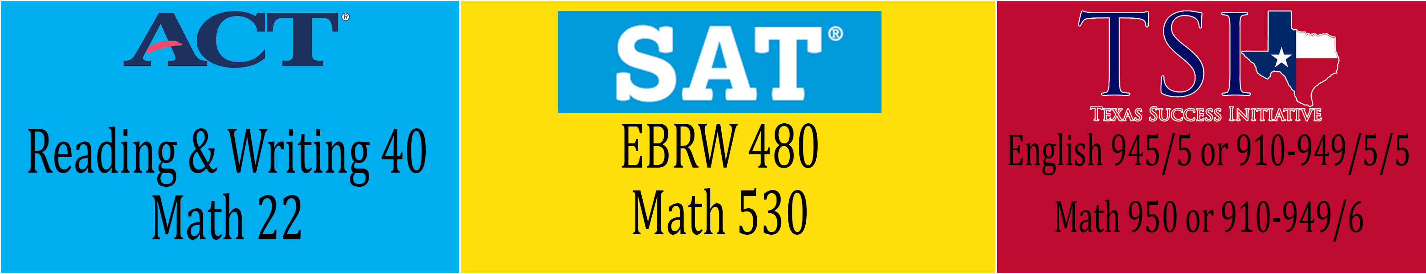
College Enrollment Benchmarks
Many schools require that students demonstrate college readiness in order to enroll in classes
Enrollment is different than admission
Texas public colleges and universities require students to exhibit this through test scores

Slide 14
Creating Your Application

Slide 15
College Application Platforms
ApplyTexas
www.applytexas.org
All Texas public and most Texas private colleges and universities
Common App
www.commonapp.org
20 Texas universities and more than 1000 others worldwide
Coalition Application
www.coalitionforcollegeaccess.org
Six Texas universities and more than 175 others nationally
Common Black College Application
www.commonblackcollegeapp.com/
More than 50 HBCUs on one application
College and university websites
Many schools have their own application process
Regardless of which platform you choose, please create your account with your personal email address
Your school email address will shut down at graduation, and you might need access to these sites afterward

Slide 16
The College Application Process

Slide 17
College Application Deadline Types
Early Decision
A binding commitment in which if you are accepted, you are obligated to attend
You can only apply to one school
Most ED deadlines are in November. Only apply if school is your top choice and you are sure you will attend
Early Action
Non-binding commitment and you can apply to multiple schools
Most EA deadlines are in November-January
Restricted Early Action allows only one application but is not binding like ED
Priority
Non-binding and you can apply to multiple schools
Most Priority deadlines are in November or December and will provide early consideration for scholarships
Regular
Deadlines are in January or later and you can apply to multiple schools

Slide 18
College Application Process
Submit your application using your platform of choice
Make sure that your application is listed in SchooLinks
Log in to your college portals as soon as you receive login information
Pay your application fee or request a fee waiver in SchooLinks
Send test scores through College Board or ACT, if applicable
Request teacher/counselor recommendations in person and follow up with SchooLinks request

Slide 19
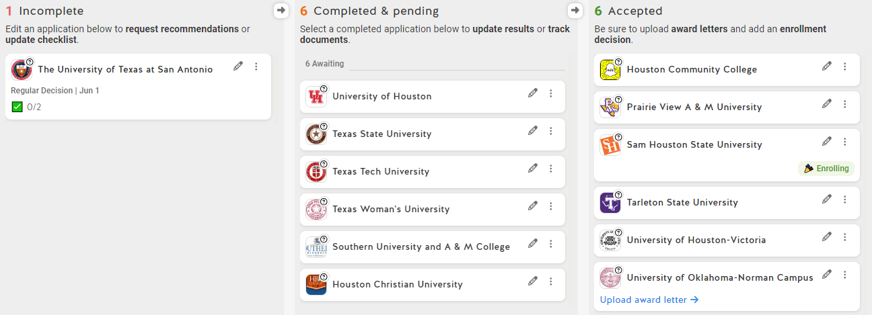
College Apps in SchooLinks
College apps must be added to SchooLinks in order to request transcripts, recommendations and application fee waivers and so that counselors can complete required Common App documentation
Adding a college application to SchooLinks will automatically trigger a transcript request

Slide 20
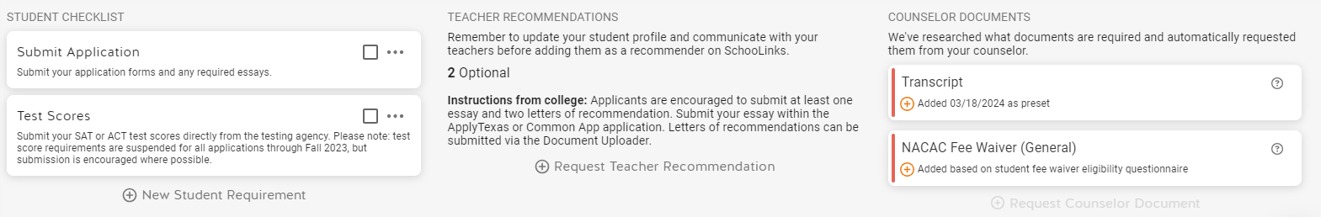
College Apps in SchooLinks
Expanded view of College Applications page
Student marks off application ‘parts’ as they are completed
Student adds request for teacher, as needed or required
Counselor or Registrar completes these tasks, depending on how student applied

Slide 21
What is Holistic Review?
Holistic review looks at the entire student in and out of the classroom
The review committee will examine the traditional test scores and classroom grades, but will also assess the applicant’s achievements, work experience, extracurricular activities, essays and more
It looks at who the student is in their heart and in their head
Pro: It provides colleges an expanded look at a student beyond the traditional
Con: It takes longer to receive admissions decisions as the committees take adequate time to review
While some schools still have auto-admit based on numbers, more and more are incorporating the holistic process to round out their student body

Slide 22
Special Programs
Aviation Programs- Specific prerequisites
Visual Arts- Portfolio Review
Performing Arts- Auditions
Disability/Accessibility Services- Accommodations in college

Slide 23
Ranking, Transcripts and College Apps
FBISD is a non-ranking district (according to rank policy EIC Local)
Rank will not be included on the transcript
FBISD provides rank and quartile to a student separate from the transcript
The rank letter is available in the Skyward Portfolio tab
Students are allowed the ability to provide this information to the colleges of their choice
Students will choose to share their rank with colleges in SchooLinks when they set up their college applications portal at the beginning of senior year. Please note that once a student has selected this option, they cannot change it
Once they make the selection, the CCRA or counseling staff will send the rank letter along with other documents to colleges for admissions
Applications platforms do not automatically submit student rank
Juniors will next be ranked in June 2026, and again in September 2026
A transcript will also be run in September that includes all coursework up to and including summer 2026
The September 2026 transcript and rank will be used for most college applications

Slide 24
Scholarships and Financial Aid

Slide 25
What are Scholarships?
Scholarships are free money that the student does not have to pay back
They can bridge the gap between the Cost of Attendance (COA) and the amount of money the student has saved for college or trade school
Academic scholarships are based on GPA, test scores and academic achievements
Merit scholarships stem from success in sports, arts or community service
Needs-based scholarships support students who demonstrate financial need
Specialized scholarships are targeted at specific demographics, majors or career paths
Scholarships can be funded by colleges or external organizations such as the Houston Rodeo

Slide 26
How To Find and Apply for Scholarships
Students will have to spend time researching and applying to scholarships: it can be a part-time job
Start as early as possible (even right now!) because most scholarships are repeated annually
Utilize your resources to identify scholarships, including SchooLinks, your colleges, internet research and friends and family
Make sure that you complete the scholarship application (including any required recommendations or transcripts) and meet all deadlines

Slide 27

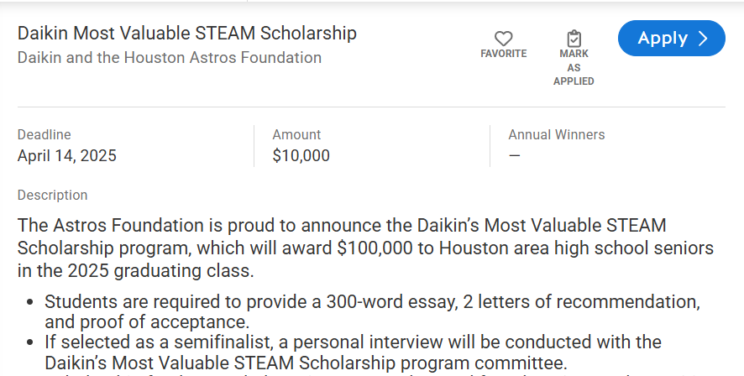
Finding Scholarships in SchooLinks
Browse to College/Scholarship Matching
Use the Eligibility, Interests and Colleges filters at the top to locate scholarships that match your needs and pursuits
The system will display the matching scholarships when you click the blue View Matches button
Review the matches and mark favorites using the heart symbol. You can also apply directly from SchooLinks.
These scholarships are posted by your campus, your district and by SchooLinks

Slide 28


Applying for the FAFSA or TASFA
Free Application for Federal Student Aid or Texas Application for State Financial Aid
Both enable students to apply for
Loans
Grants
Scholarships
Work-study programs
Both open on October 1
All seniors will complete a FAFSA, TASFA or opt-out form as a graduation requirement

Slide 29
Military Options

Slide 30

Military Service
Military academies are highly competitive and prepare students for service in the officer corps of the Army, Navy or Air Force
The US Military Academy at West Point, the US Naval Academy, the US Air Force Academy
The Reserved Officer Training Corps is a college-based program for training commissioned officers of the United States armed forces.
The ROTC scholarship is viable at many different colleges and universities and includes full tuition benefits
Enlistment in active duty or in the reserves requires a commitment for 4-5 years, depending on the branch
Your campus CCRA can assist with:
Connecting you with a local recruiter
Helping to identify the variety of MOSs available that are tailored to your skill set
Registration for a local ASVAB administration to identify an appropriate military career

Slide 31
Your College and Career Readiness Advisors

Slide 32
College and Career Readiness Advisors
Austin High School
Brandon Byrd
brandon.byrd@fortbendisd.gov
Bush High School
Tiffani Haynes
tiffani.haynes@fortbendisd.gov
Clements High School
Raven Hollins-Crowder
raven.hollins@fortbendisd.gov
Crawford High School
Dejah Walea
dejah.walea@fortbendisd.gov
Dulles High School
Kasha Williams kasha.williams@fortbendisd.gov
Elkins High School
Veronica Harris veronica.harris@fortbendisd.gov
Hightower High School
Jackie Hidalgo jacquelyn.hidalgo@fortbendisd.gov
Kempner High School
Chatney Hines chatney.hines@fortbendisd.gov
Marshall High School
Daphne Thompson-Bennett daphne.thompson@fortbendisd.gov
Ridge Point High School
Susanna Jakubik susanna.jakubik@fortbendisd.gov
Travis High School
Becky Martinez becky.martinez@fortbendisd.gov
Willowridge High School
Kimberly Green
kimberly.green@fortbendisd.gov
Assistant Director of School Counseling
Dr. Leshunda Page
leshunda.page@fortbendisd.gov

Slide 33
Thank you! Your campus CCRA will share these resources with you.

